Slide 1
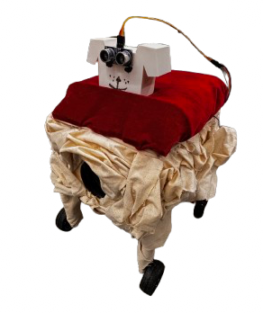
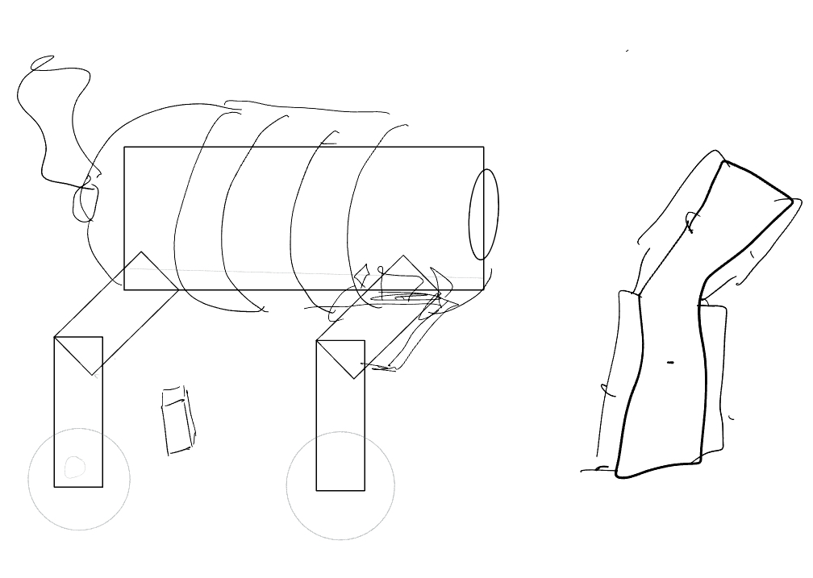
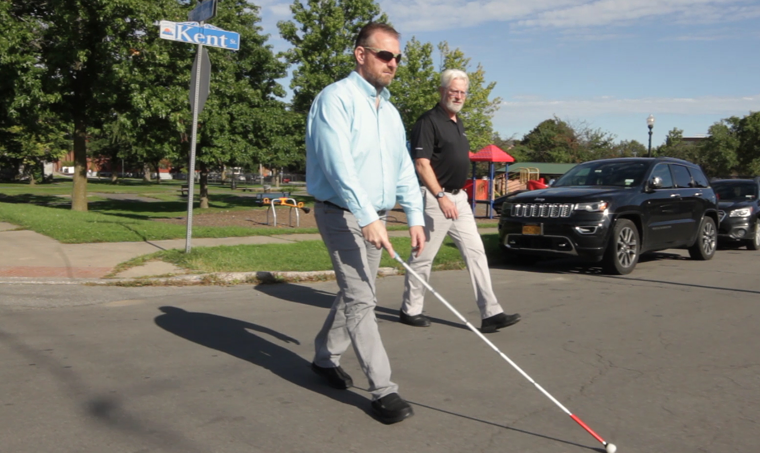
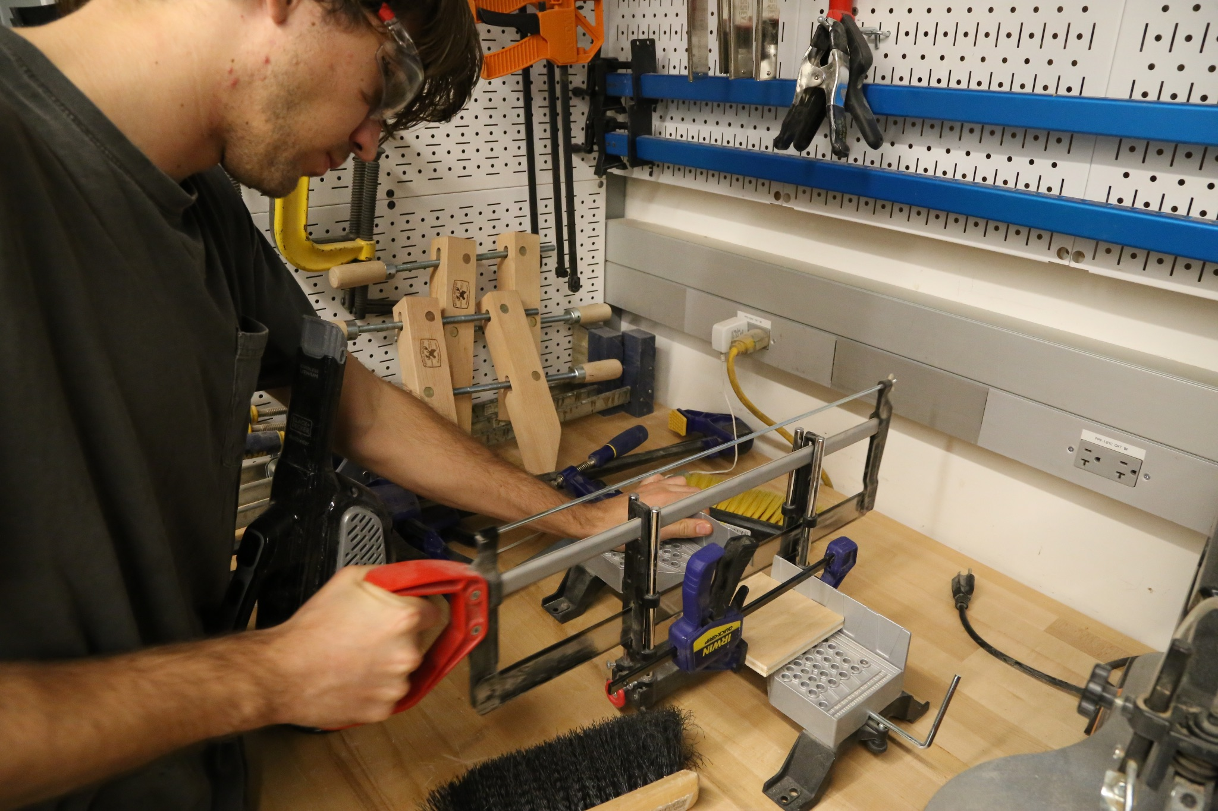
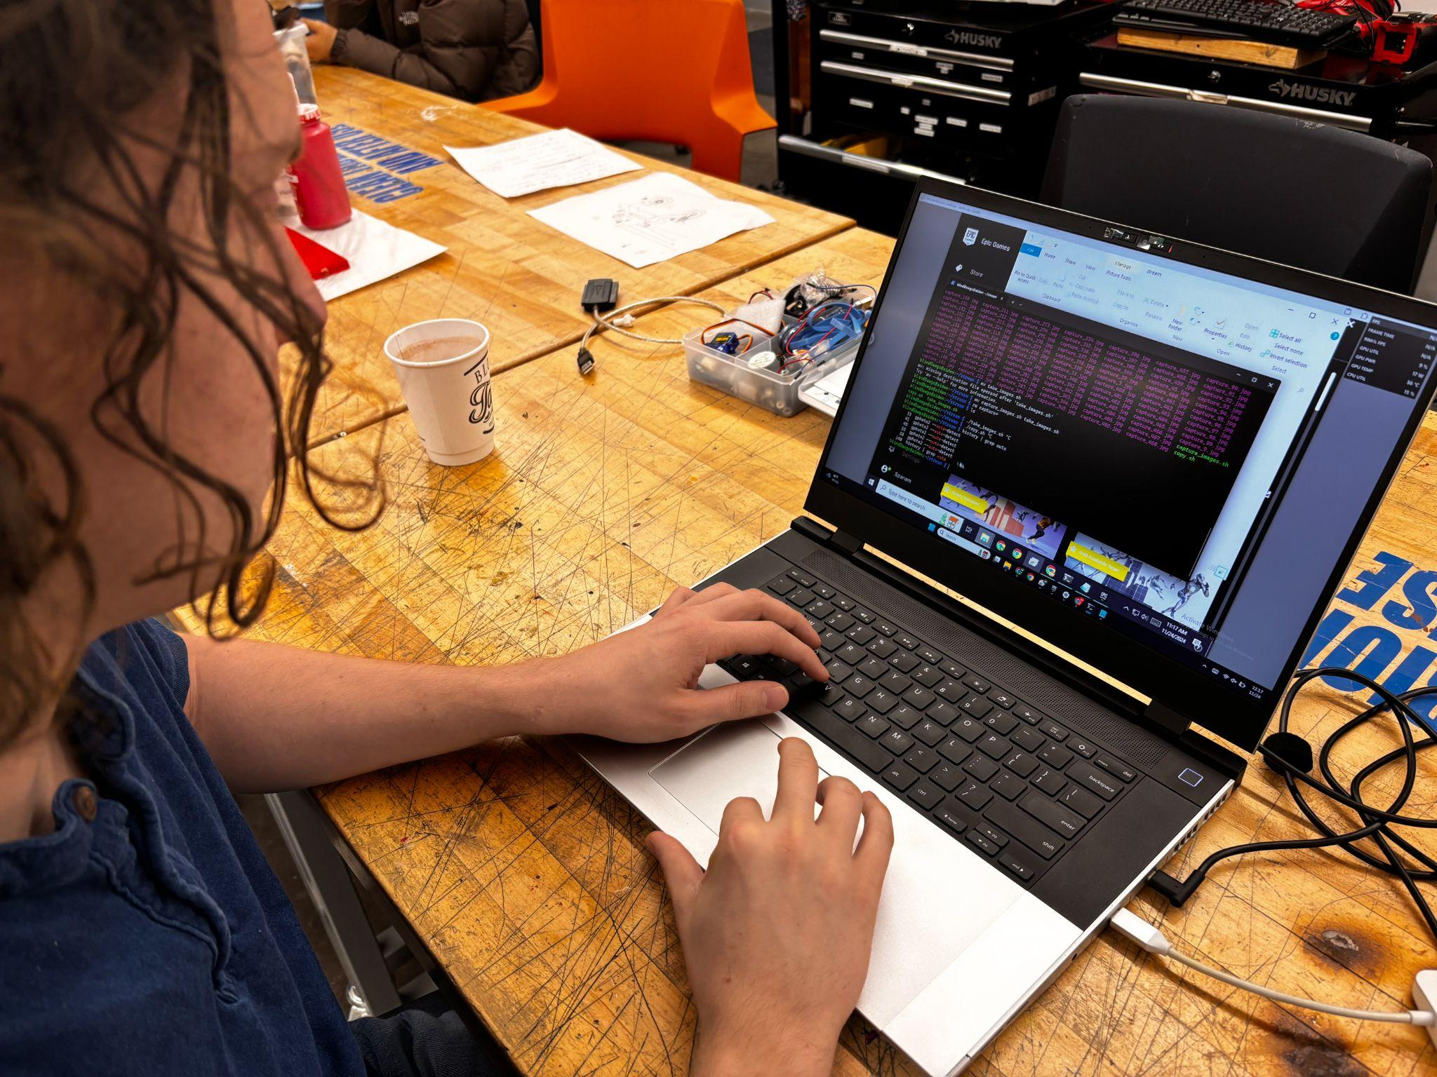
Blind, the Dog
Problem
Process
A mobility assistant
1 million americans suffer from complete blindness with tens more suffering from some form of vision loss. That number is set to double by the year 2050 according to the CDC. However, in the past few decades, mobility aid technology has remained relatively the same.
Sketch/Design
Build
The most prevalent existing solution, walking sticks, have many shortcomings. With an inability to detect obstacles above ground, a proclivity towards getting stuck in cracks, and a complete lack of safety around moving objects, walking sticks have been long overdue for an innovative replacement.
Software
Blind is a fun, friendly aid to the visually impaired that maps a room in real time!

Slide 2
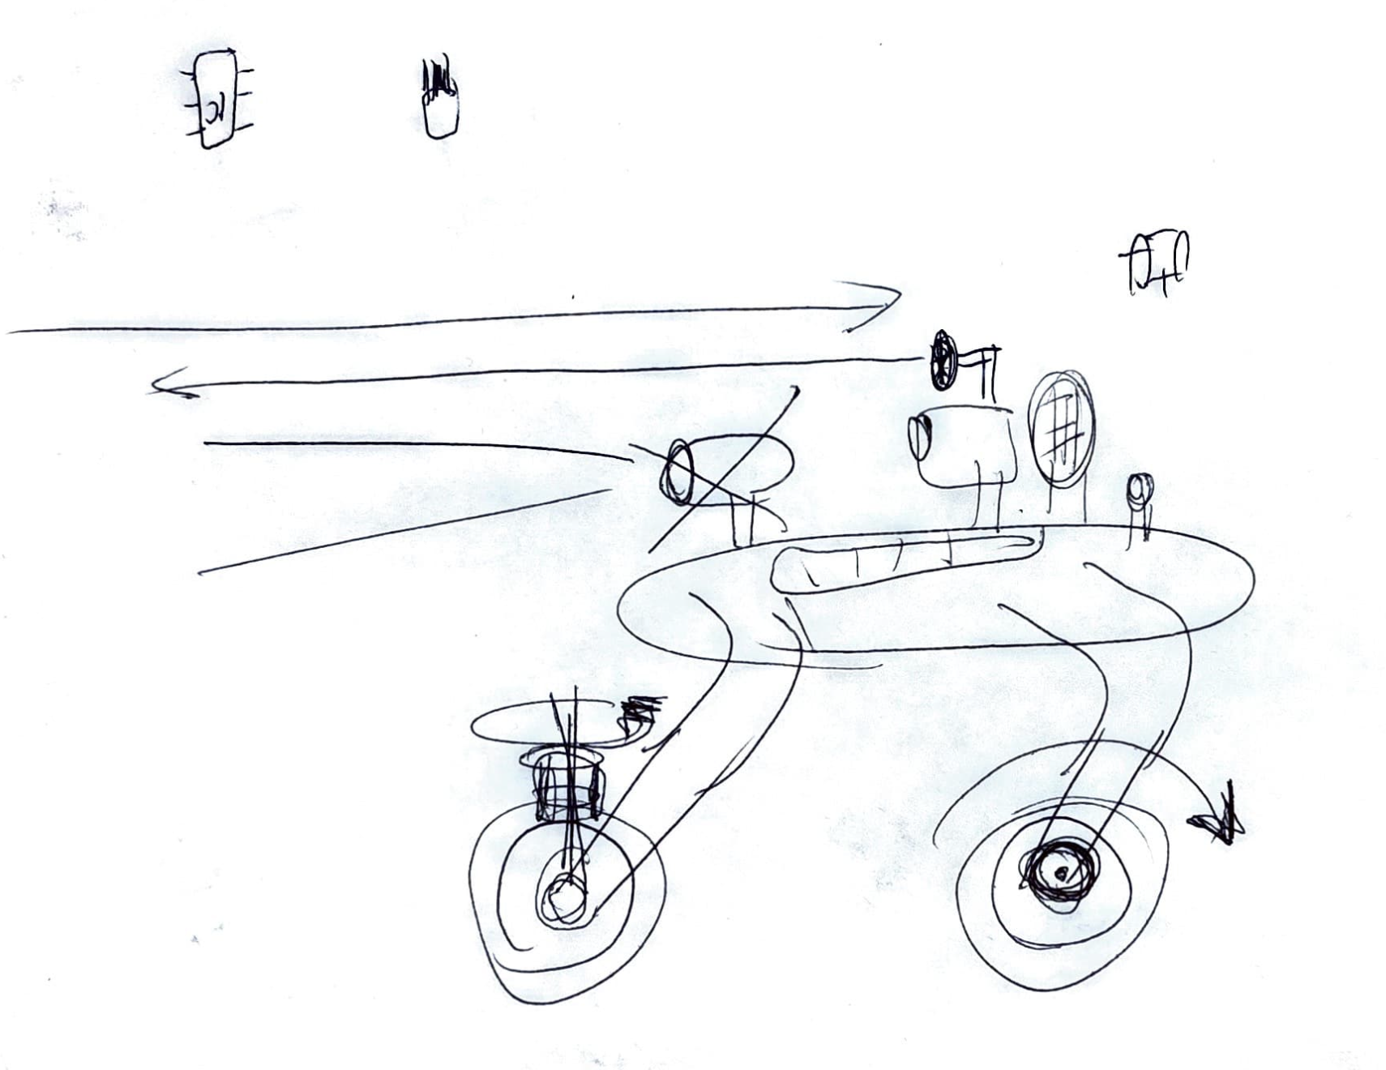
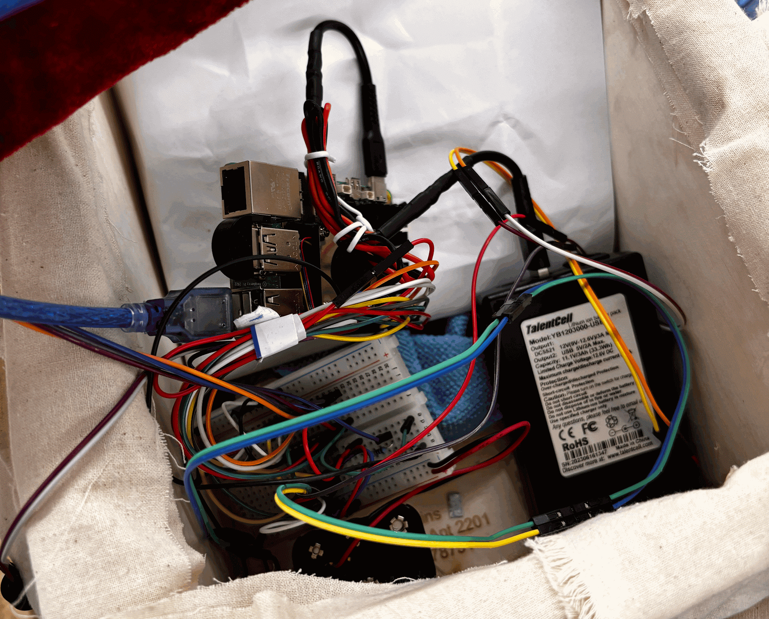
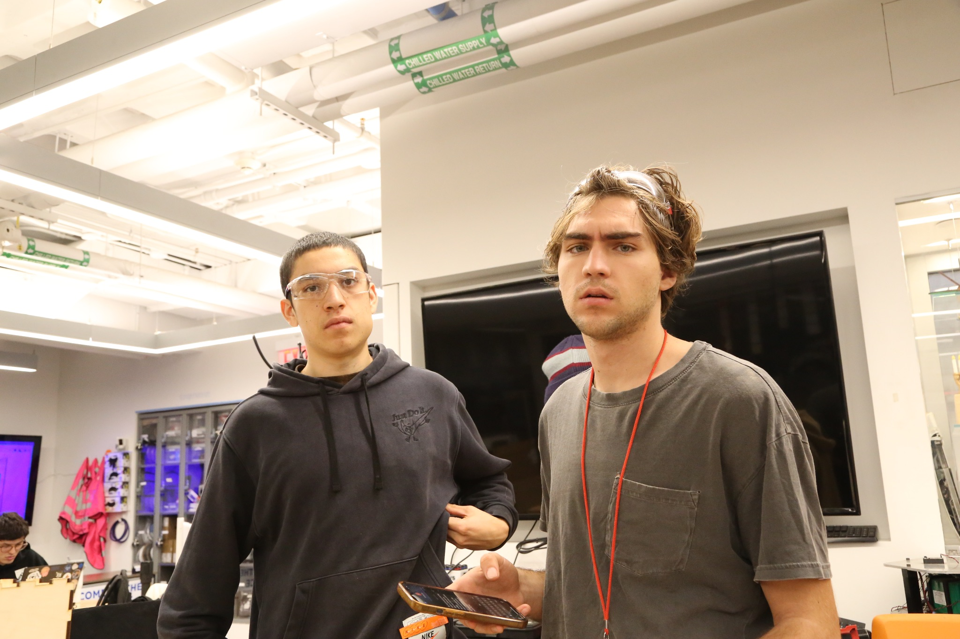
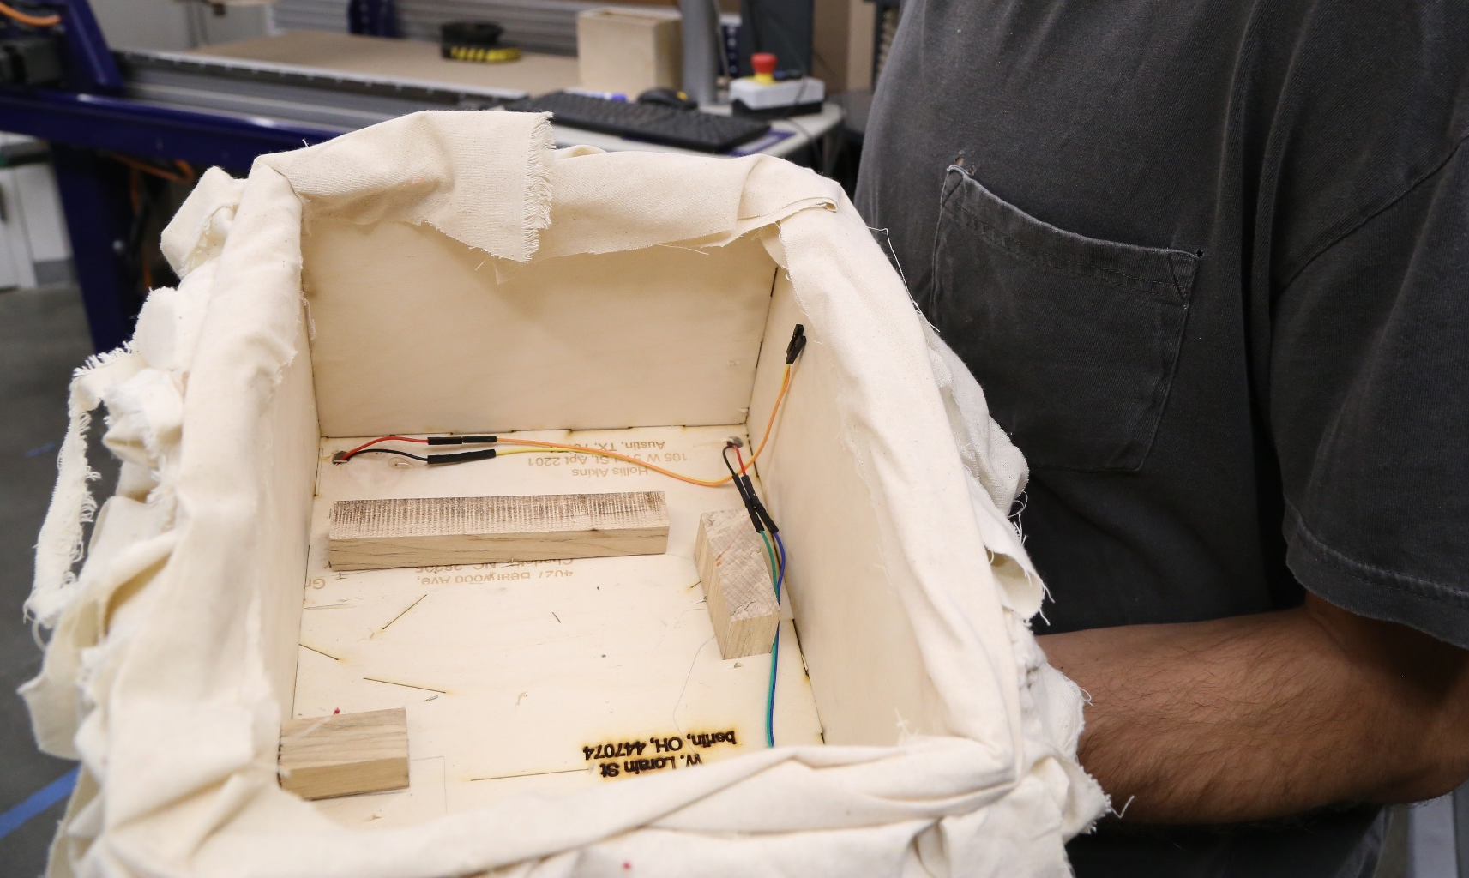
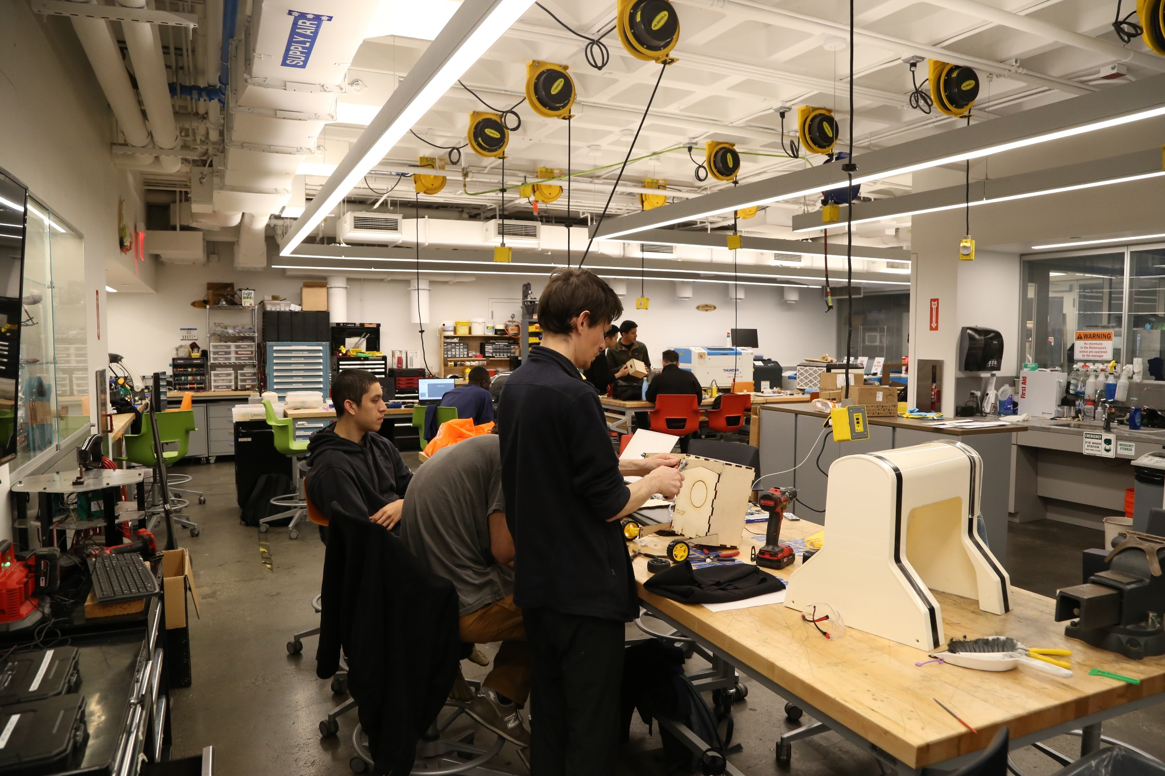
Build

Slide 3
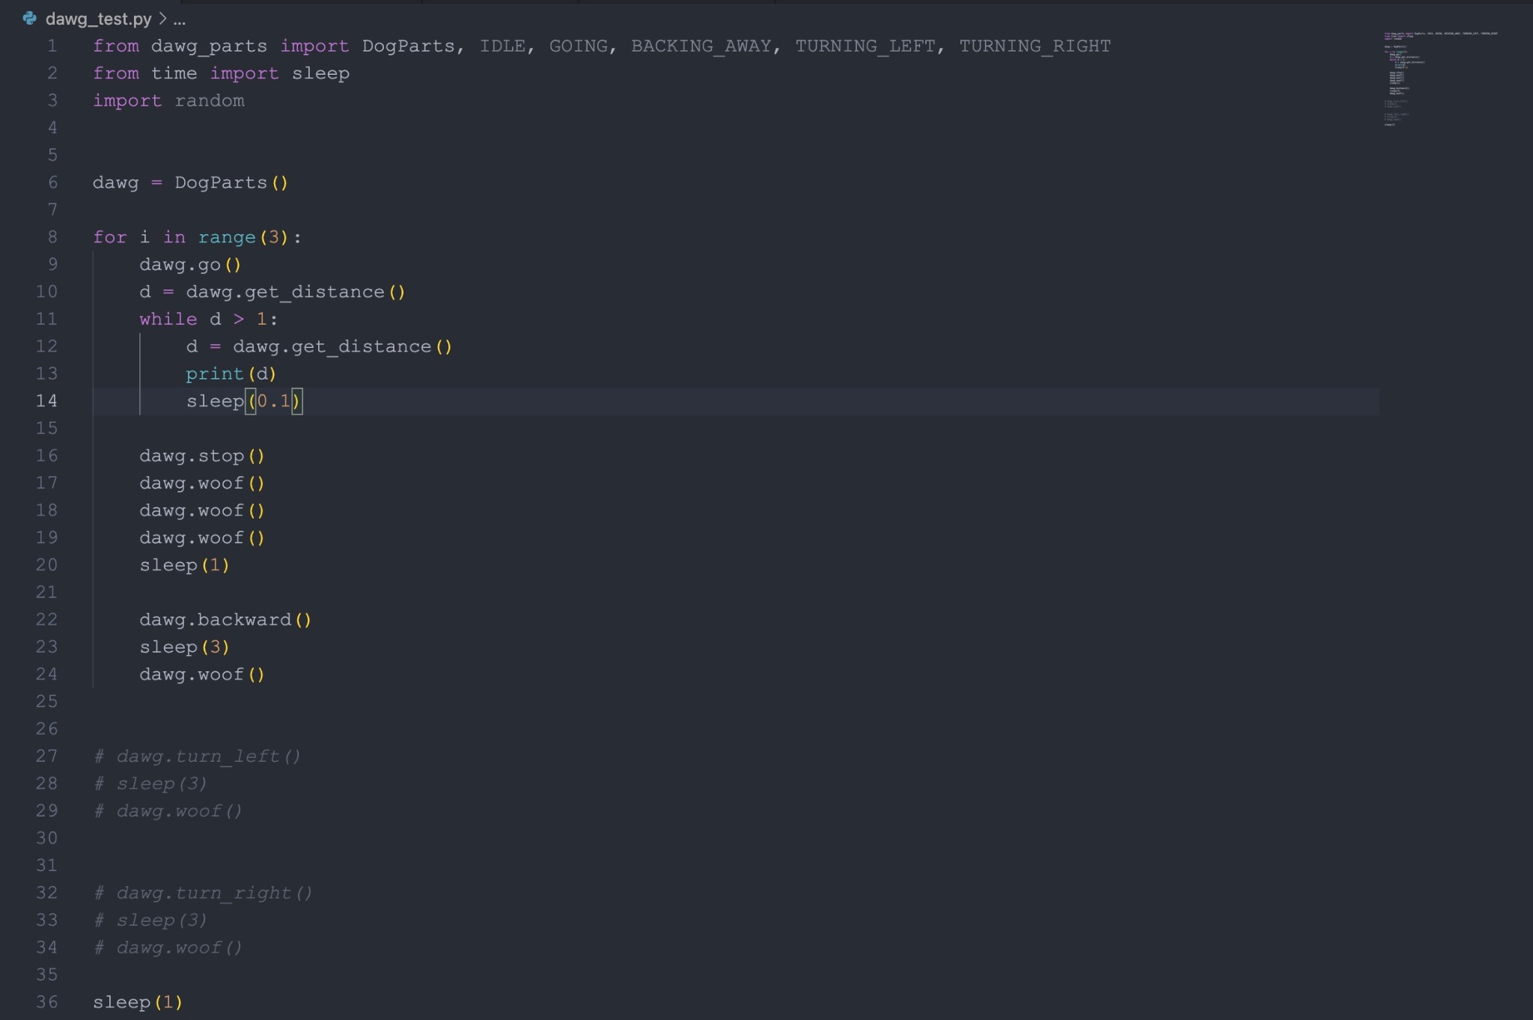
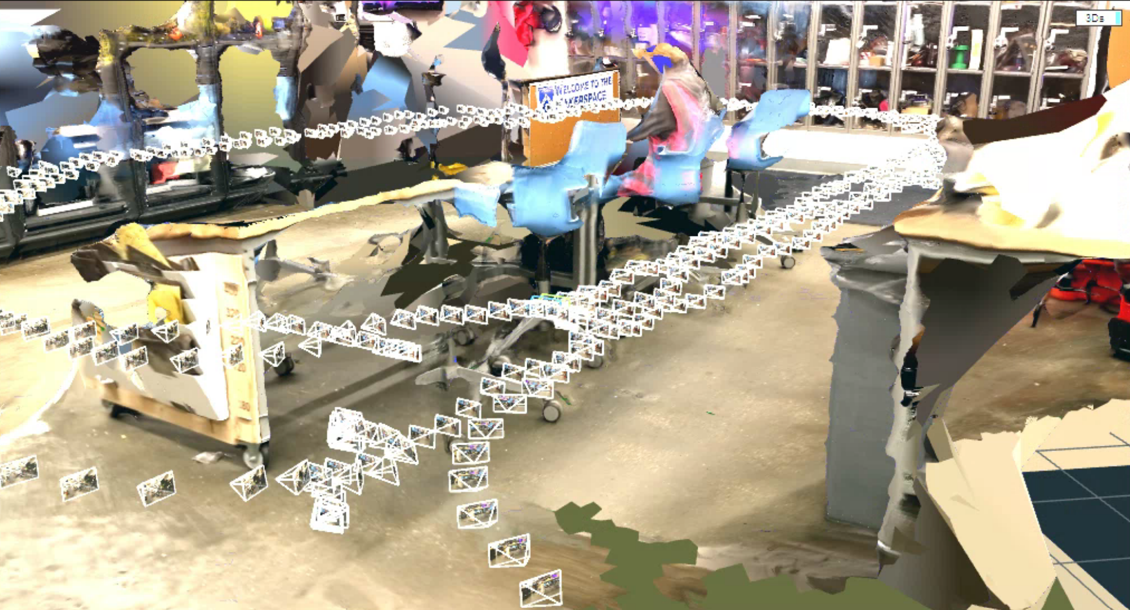
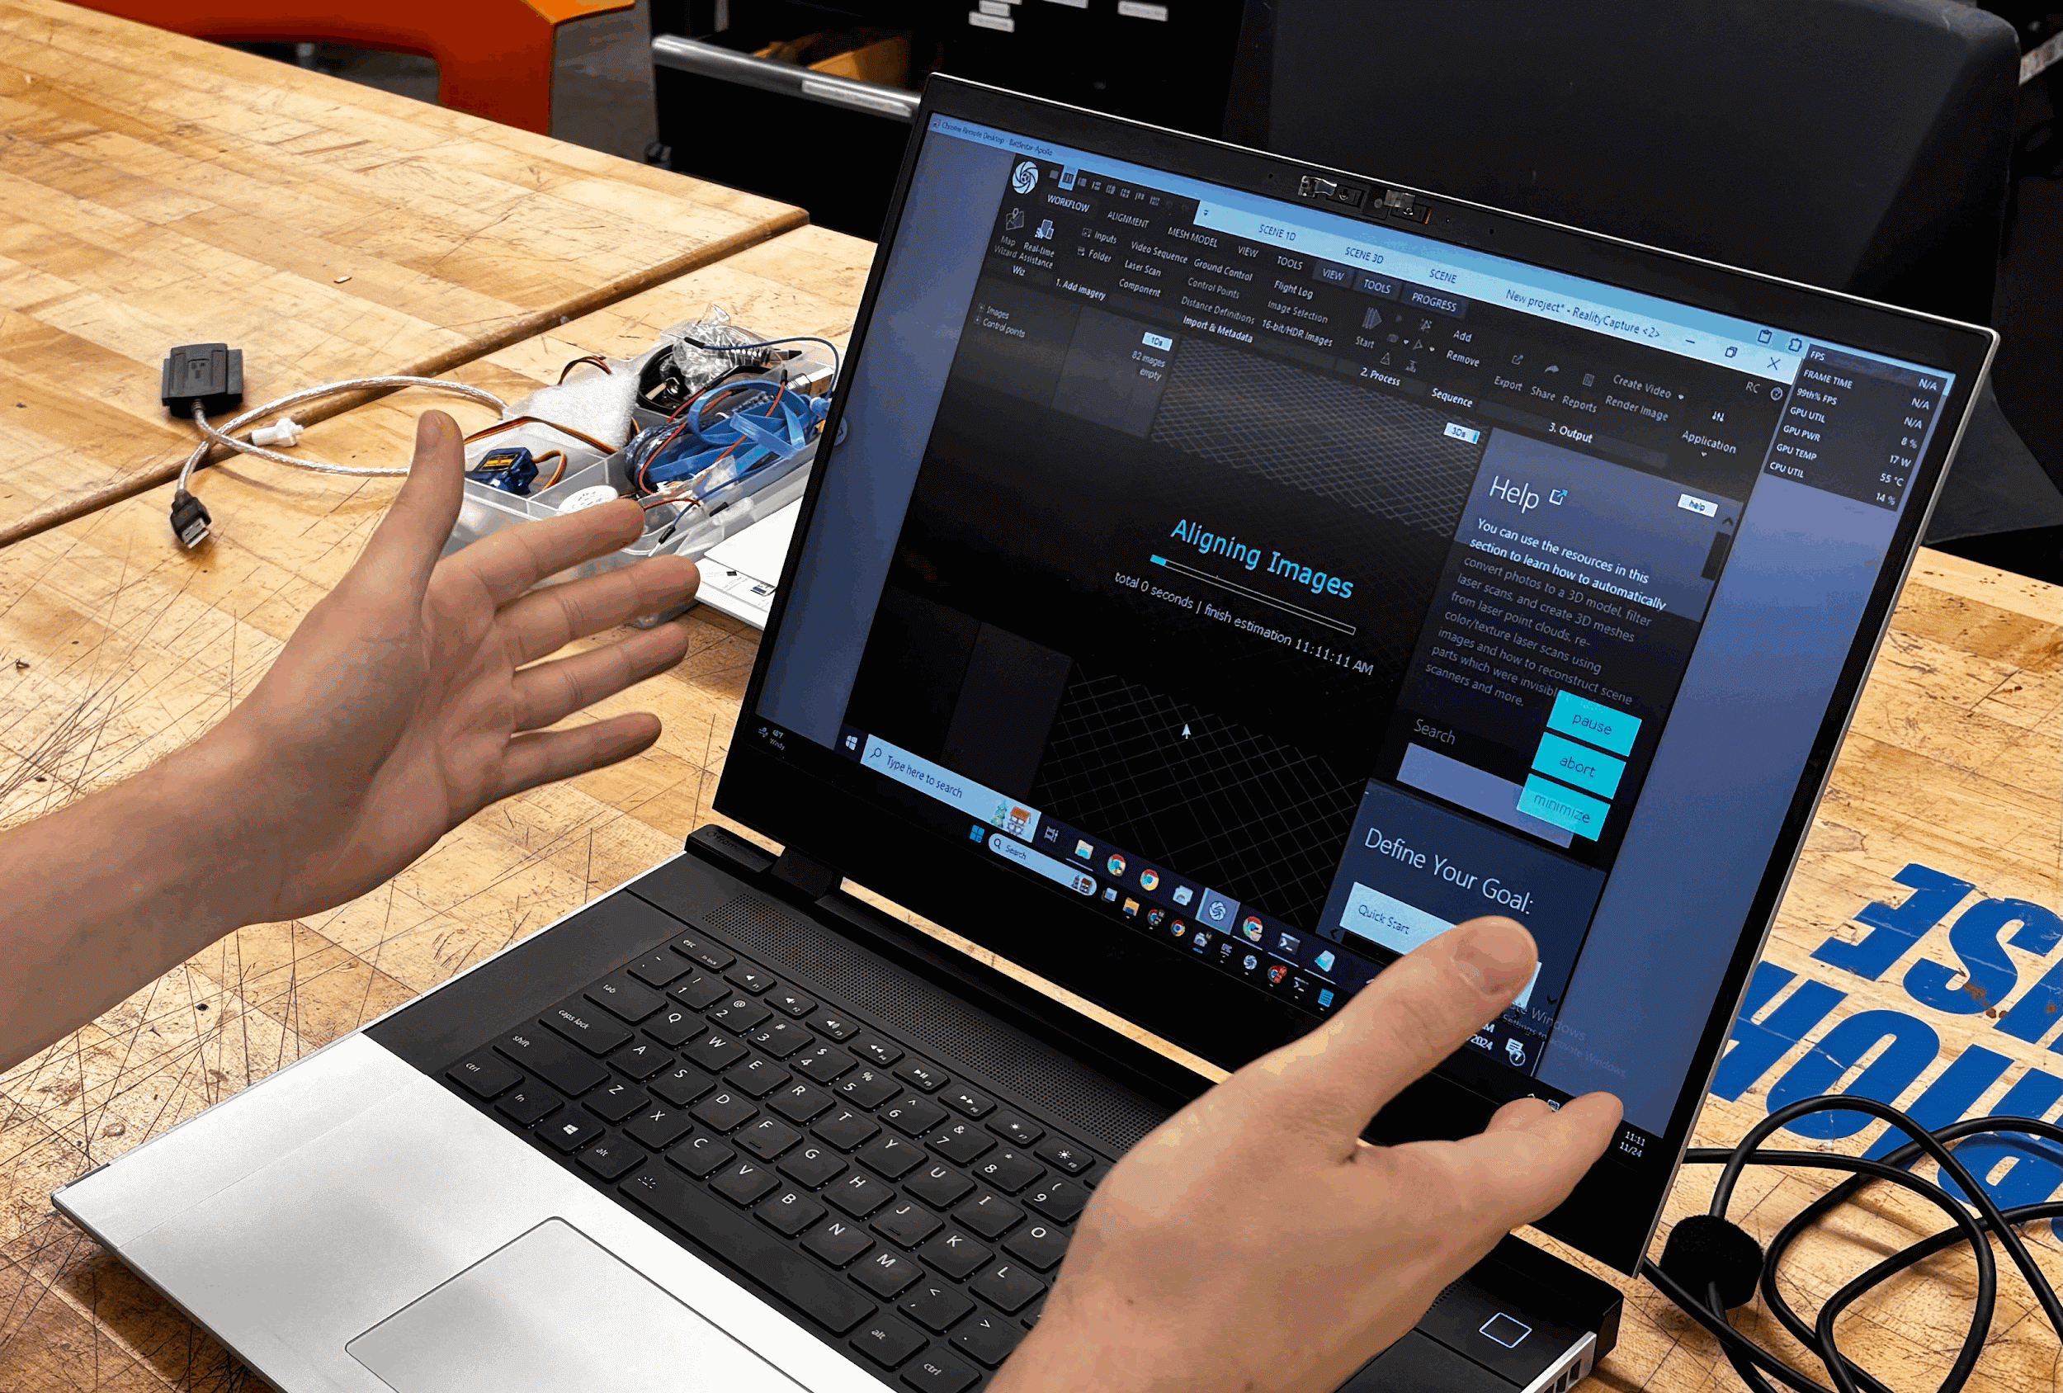
Software

Slide 4

Final Product

